Slide 1
LYNCESTIS LLP
Managed Account Programs
March 1, 2019
FOR ACCREDITED INVESTORS USE ONLY AND MAY NOT BE USED WITH THE GENERAL PUBLIC

Slide 2
Table of Contents
I. Introduction
- The Lyncestis LLP Trading Team
- What Do We Offer
- How is Our Investment Process Different
II. Strategies Overview, Performance and Risk Analysis
Foreign Currency (FX) Portfolio Trading Strategies
Investment Philosophy
1. FX Index Arb – Currency Trading Program
2. FX Basket Quant – Currency Trading Program
3. FX Quant 11 – Currency Trading Program
4. FXC – Currency Trading Program
S&P 500 Volatility (VIX) Trading Strategies
5. V1 – Volatility Trading Program
6. V2 – Volatility Trading Program
7. V4 – Volatility Trading Program
III. Multi Strategy Performance
IV. Execution and Risk Controls
V. Key Investment Terms
VI. Risk Notice
VII. Getting Started
VIII. Contact Information

Slide 3

I. Introduction to the Quant Trading Team
Lyncestis LLP
- Quantitative research and trading firm
- Formed in 2018 under the laws of England and Wales
- Principal place of business: Bitola, Macedonia
Managing member: Dejan Trajkovski
Exempt trading advisor - CFTC Reg. 4.14(a)(8),(10)
NFA ID: 0418790 (Exempt CTA)
Key people:
Dejan Trajkovski, Portfolio Manager
Responsible for development, evaluation and implementation of Lyncestis LLP’s quantitative trading systems
Development of all aspects of trading policies and procedures
BS degree in mechanical engineering
MS and PhD in Computational Mechanics
Professor of Theoretical Mechanics at Faculty of Mech. Engineereing, University “St. Kliment Ohridski”, Bitola
- Passed FINRA Series 3 exam with a score of 93%
Quantitative trading experience of more than 10 years
Biography at www.fx-quant.com/Developer.htm
- Trading related CV
Ljuben Risteski, Quant Trader
Implementation of al trading procedures
Maintenance of IT infrastructure and trading platforms
Reconciliation of trades
Performance reporting
Computer programmer
BS and MS in Physics
Trading experience of more than 5 years
To Table of Contents

Slide 4

What Do We Offer
Lyncestis LLP is a limited liability partnership engaged in the quantitative trading research and management of client and proprietary assets. Lyncestis LLP offers separately managed account programs and services across currency, equity and commodity asset classes and related derivative instruments in the global markets for an international clientele.
The investment strategies of Lyncestis LLP include quantitative currency trading (managed Forex), quantitative equity long/short and S&P 500 volatility (VIX) trading.
Our mission is to provide investors with superior risk-adjusted returns by carefully developing and implementing innovative alternative investment products.
We are both managers and investors in our trading programs and strive to deliver to our clients the level of performance, integrity and service we demand for ourselves.

Slide 5

How is Our Investment Process Different – Currency Portfolio Trading
1.) The world does not need another trend following approach. We developed portfolio trading strategies that exploit currency diversification and extract profit from the price noise. The rates of return should be very stable on risk adjusted basis. The average and maximum leverage are carefully determined in order to avoid disastrous drawdowns.
2.) Fx Quant 11, FX Basket Quant, Fx Index Arb and FXC, our portfolio trading strategies, show a significant degree of stability and robustness. They are not curve fitted, i.e. they are relatively insensitive to parameter variations. This usually indicates a relative insensibility to changing market conditions.
3.) The emphasis is on capital preservation and absolute return (alpha) generation, independent from the equity market direction. We design trading systems to last long, avoiding excessive leverage and large returns and risks.
4.) The strategies trade in small increments, at regular time intervals. They do not depend on market news and price breakouts. As such, they are insensitive to price slippage and spread costs are kept low.
5.) There is no upper limit on the account size. By trading more frequently we can manage accounts of virtually any size.
6.) Slippage control and order placement mechanism is used, in order to minimize, or cancel, slippage and spread costs.
7.) We found that more than 80% of the performance we found doing a simple Google search for "managed Forex" is NOT TRUE. Our performance record is based on account statements from real trading and we offer our account statements and performance calculations for inspection.
8.) We are constantly working and improving our trading strategies - please also see www.vol-quant.com and www.equity-quant.com.

Slide 6
II. Strategies Overview
Foreign Currency (FX) Portfolio Trading Strategies
Investment Philosophy
1. FX Index Arb – Currency Trading Program
2. FX Basket Quant – Currency Trading Program
3. FX Quant 11 – Currency Trading Program
4. FXC- Currency Trading Program
S&P 500 Volatility (VIX) Trading Strategy
5. V1 – Volatility Trading Program
6. V4 – Volatility Trading Program
S&P 500 Options Trading Strategy
7. SP Quant - S&P 500 Index Trading Program

Slide 7
Investment Philosophy – Currency Portfolio Trading
(FX Index Arb, FX Basket Quant, FX Quant 11, FXC – Currency Trading Programs)
We believe:
• Currency markets are highly, but not completely, efficient
• Price anomalies persist that affect currency returns
• Currency prices move with frequent retracements
• A quantitative strategy exploiting these inefficiencies may generate absolute returns (pure alpha)
• It is crucial to manage strategy risk relative to strategy return
• Consistent absolute returns may be achieved by executing a disciplined approach that addresses both risk and return
We focus on:
• Rigorous strategy design and testing
• Systematic portfolio construction with daily positions adjustments
• Disciplined strategy execution and generation of superior risk-adjusted returns
• Risk management

Slide 8
Strategy #1: FX Index Arb – Currency Trading Program (FXIA)
The Strategy
- Uses statistical methods - quantitative analysis of time series of currency prices.
- Creates a complex portfolio of 10 global (G10) currencies
- The strategy forms indexes of the 10 base currencies, which depend on the prices of the remaining 9 currencies against the index currency.
- It trades the components of each index (counter trend, short gamma) against the index itself (trend following, long gamma).
- Exactly the same rules are used for counter trend and trend trading.
- The point is to make use of the higher volatility in individual components against the lower volatility of indexes (as proven by the Modern Portfolio Theory).
- Based on positions of components and indexes (a total of 90 currency crosses), positions are then consolidated into the base 10 currencies, i.e. 9 currency pairs against the US Dollar.
- The resulting positions are then implemented in the market. The trading strategy is always in the market, but portfolio weights are adjusted daily.
Profit Generation Process
- Each currency pair, depending on its portfolio weight and its daily price return, has a contribution to strategy daily rate of return (ROR).
- Some positions will produce positive and some will produce negative rates of return.
- The strategy, through active portfolio composition and adjustment, attempts to generate positive returns over time.
- The strategy is in the market 100% of time and daily rates of return are calculated on a mark-to-market basis.
To Table of Contents

Slide 9
Strategy #1: FX Index Arb – Cont’d
Strategy Leverage
- Leverage is defined as a ratio between the USD value of long portfolio components and the trading size (NAV)
- The average combined leverage is around 0.86 and the maximum leverage should not exceed 2.0.
- The position size limit for each currency (USD denominated) is 90% of the trading size (NAV)
- The maximum margin-to-equity ratio should not exceed 5% (if margin requirement for a 100,000 currency lot is $1,000).
Risk Control
- Is achieved through a variety of means which in most market conditions should minimize drawdowns.
- The first is portfolio construction and diversification (trend and counter trend trading in indexes and their components);
- Second is portfolio concentration control through position size adjustment according to account size,
- Third is catastrophic stop based on money management rules.

Slide 10
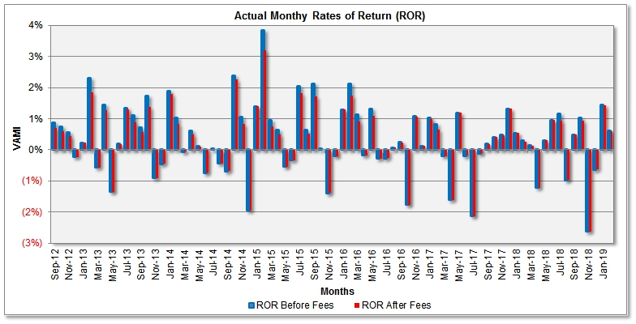
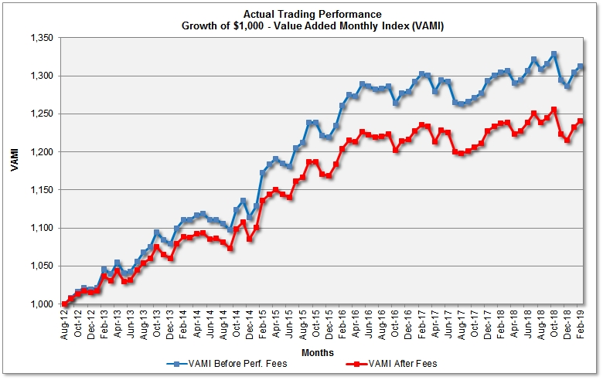
Strategy #1: FX Index Arb – Performance Summary (Real Trading)
PAST PERFORMANCE IS NOT NECESSARILY INDICATIVE OF FUTURE RESULTS
 | Jan | Feb | Mar | Apr | May | Jun | Jul | Aug | Sep | Oct | Nov | Dec | YTD | VAMI
2012 | See back testing results of the currently traded strategy |  |  |  |  |  |  |  | 0.87% 0.70%* | 0.75% 0.60%* | 0.56% 0.45%* | (0.23%) (0.23%)* | 2.20% 1.76%* | 1,022.0 1,017.6*
2013 | 0.23% 0.23%* | 2.30% 1.84%* | (0.56%) (0.56%)* | 1.44% 1.27%* | (1.35%) (1.35%)* | 0.19% 0.19%* | 1.34% 1.31%* | 1.10% 0.88%* | 0.72% 0.58%* | 1.73% 1.39%* | (0.91%) (0.91%)* | (0.45%) (0.45%)* | 5.86% 4.43%* | 1,079.4 1,060.2*
2014 | 1.89% 1.79%* | 1.03% 0.83%* | (0.05%) (0.05%)* | 0.61% 0.50%* | 0.12% 0.10%* | (0.74%) (0.74%)* | 0.01% 0.01%* | (0.44%) (0.44%)* | (0.68%) (0.68%)* | 2.37% 2.27%* | 1.06% 0.84%* | (1.95%) (1.95%)* | 3.18% 2.42%* | 1,113.7 1,085.8*
2015 | 1.40% 1.40%* | 3.84% 3.19%* | 0.95% 0.76%* | 0.63% 0.51%* | (0.54%) (0.54%)* | (0.33%) (0.33%)* | 2.05% 1.82%* | 0.64% 0.51%* | 2.13% 1.71%* | 0.01% 0.01%* | (1.38%) (1.38%)* | (0.20%) (0.20%)* | 9.46% 7.59%* | 1,219.1 1,168.3*
2016 | 1.30% 1.30%* | 2.12% 1.76%* | 1.14% 0.91%* | (0.18%) (0.18%)* | 1.31% 1.09%* | (0.28%) (0.28%)* | (0.26%) (0.26%)* | 0.07% 0.07%* | 0.25% 0.25%* | (1.76%) (1.76%)* | 1.08% 1.08%* | 0.12% 0.12%* | 4.94% 4.10%* | 1,279.3 1,216.2*
2017 | 1.02% 0.98%* | 0.82% 0.66%* | (0.21%) (0.21%)* | (1.61%) (1.61%)* | 1.19% 1.19%* | (0.18%) (0.18%)* | (2.12%) (2.12%)* | (0.11%) (0.11%)* | 0.19% 0.19%* | 0.41% 0.41%* | 0.48% 0.48%* | 1.32% 1.32%* | 1.14% 0.93%* | 1,293.9 1,227.6*
2018 | 0.53% 0.53%* | 0.29% 0.26%* | 0.15% 0.12%* | (1.22%) (1.22%)* | 0.30% 0.30%* | 0.96% 0.96%* | 1.17% 0.93%* | (0.97%) (0.97%)* | 0.49% 0.49%* | 1.04% 0.93%* | (2.63%) (2.63%)* | (0.64%) (0.64%)* | (0.59%) (0.99%)* | 1,286.3 1,215.5*
2019 | 1.43% 1.43%* | 0.61% 0.61%* |  |  |  |  |  |  |  |  |  |  | 2.05% 2.05%* | 1,312.6 1,240.4*
For current, more detailed performance report and performance analytics please visit
www.fx-quant.com/FXIA/PerformanceFXIA.htm
* Net of 20% performance fee

Slide 11
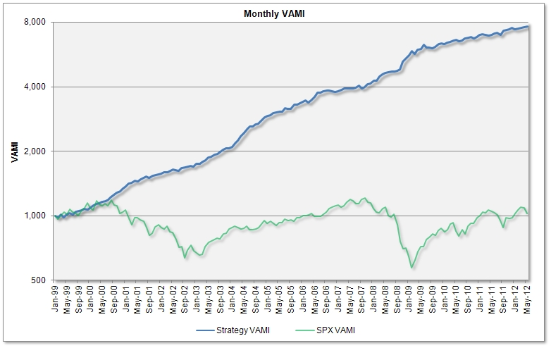
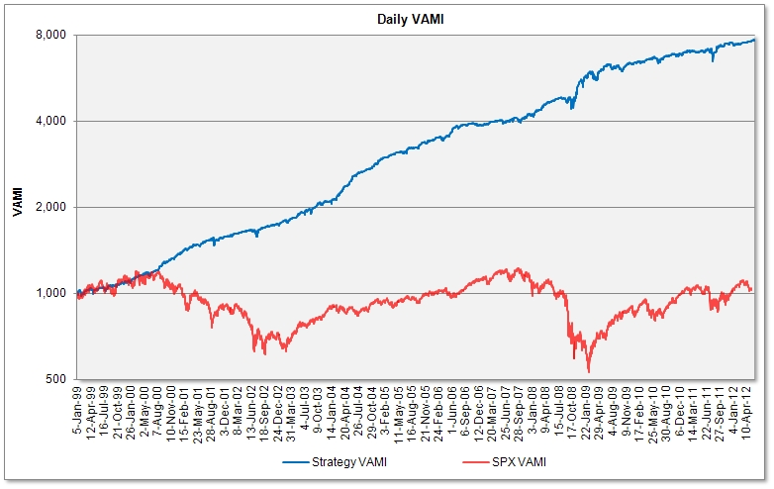
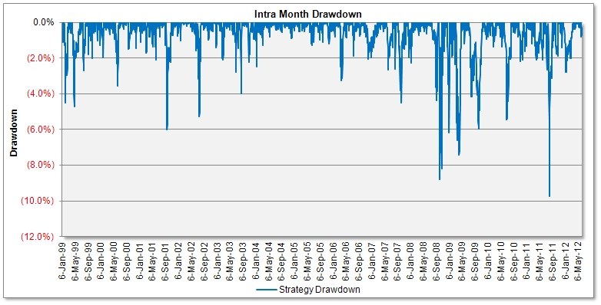
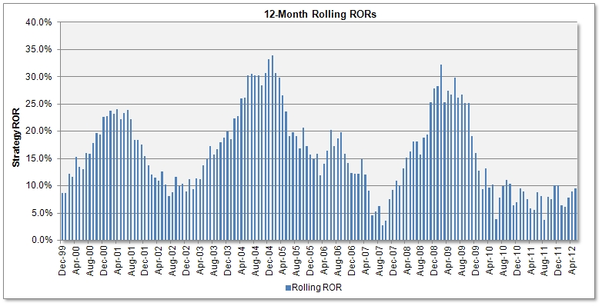
Strategy #1: FX Index Arb – Back Testing Results
HYPOTHETICAL OR SIMULATED PERFORMANCE RESULTS HAVE CERTAIN INHERENT LIMITATIONS. UNLIKE AN ACTUAL PERFORMANCE RECORD, SIMULATED RESULTS DO NOT REPRESENT ACTUAL TRADING. ALSO, SINCE THE TRADES HAVE NOT ACTUALLY BEEN EXECUTED, THE RESULTS MAY HAVE UNDER-OR-OVERCOMPENSATED FOR THE IMPACT, IF ANY, OF CERTAIN MARKET FACTORS, SUCH AS LACK OF LIQUIDITY. SIMULATED TRADING PLATFORMS IN GENERAL ARE ALSO SUBJECT TO THE FACT THAT THEY ARE DESIGNED WITH THE BENEFIT OF HINDSIGHT. NO REPRESENTATION IS BEING MADE THAT ANY ACCOUNT WILL OR IS LIKELY TO ACHIEVE PROFITS OR LOSSES SIMILAR TO THOSE SHOWN.
For more detailed back testing report please visit www.fx-quant.com/FXIA/BackTestFxIndArb.htm

Slide 12
Strategy #2: FX Basket Quant – Currency Trading Program (FXBQ)
The Strategy
- FXBQ is a systematic, quantitative trading program, which trades currencies in the cash ("spot") markets. The strategy creates a complex portfolio of 10 global (G10) currencies and adjusts its components daily.
- The strategy exploits the asymmetry of percentage increases and decreases of price returns. For example, if the NZDCHF price return is positive, the CHFNZD return will be negative, but the sum of these two returns will always be positive, although denominated in different currencies.
- The strategy trades all currency crosses between 9 base currencies, accumulates returns in base currencies and periodically converts them into USD.
- Based on positions of all components (a total of 72 currency crosses), positions are consolidated into the base 9 currencies against the US Dollar.
- The resulting positions are then implemented in the market. The trading strategy is always in the market, but portfolio weights are adjusted daily.
Profit Generation Process
- Each currency pair, depending on its portfolio weight and its daily price return, has a contribution to strategy daily rate of return (ROR).
- Some positions will produce positive and some will produce negative rates of return.
- The strategy, through active portfolio composition and adjustment, attempts to generate positive returns over time.
- The strategy is in the market 100% of time and daily rates of return are calculated on a mark-to-market basis.

Slide 13
Strategy #2: FX Basket Quant – Cont’d
Strategy Leverage
- Leverage is defined as a ratio between the USD value of long portfolio components and the trading size (NAV)
- The average combined leverage is around 0.56 and the maximum leverage should not exceed 2.0.
- The position size limit for each currency (USD denominated) is 100% of the trading size (NAV)
- The maximum margin-to-equity ratio should not exceed 5% (if margin requirement for a 100,000 currency lot is $1,000).
Risk Control
- Is achieved through a variety of means which in most market conditions should minimize drawdowns.
- The first is portfolio construction and diversification (trend and counter trend trading in indexes and their components);
- Second is portfolio concentration control through position size limitation according to account size (the position size limit for each currency is currently set to 100% of NAV);
- Third is catastrophic stop based on money management rules (can be set by the investor).
To Table of Contents

Slide 14
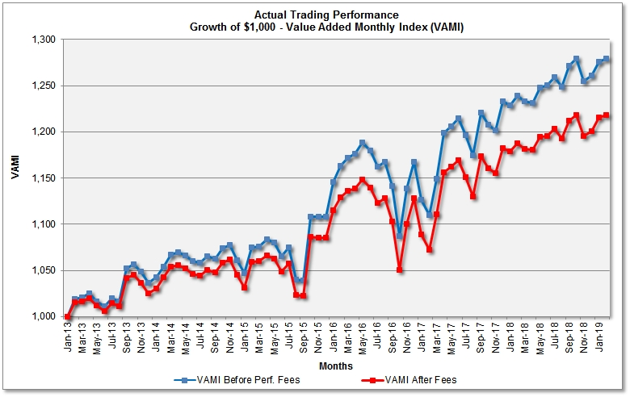
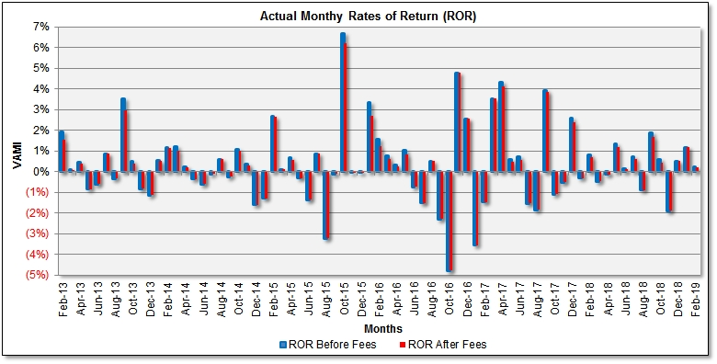
Strategy #2: FX Basket Quant – Performance Summary (Real Trading)
PAST PERFORMANCE IS NOT NECESSARILY INDICATIVE OF FUTURE RESULTS
 | Jan | Feb | Mar | Apr | May | Jun | Jul | Aug | Sep | Oct | Nov | Dec | YTD | VAMI
2013 | - | 1.93% 1.55%* | 0.13% 0.10%* | 0.47% 0.38%* | (0.84%) (0.84%)* | (0.59%) (0.59%)* | 0.87% 0.87%* | (0.32%) (0.32%)* | 3.51% 2.99%* | 0.49% 0.39%* | (0.82%) (0.82%)* | (1.12%) (1.12%)* | 3.67% 2.53%* | 1,036.7 1,025.3*
2014 | 0.54% 0.54%* | 1.16% 1.16%* | 1.23% 1.04%* | 0.24% 0.19%* | (0.34%) (0.34%)* | (0.60%) (0.60%)* | (0.12%) (0.12%)* | 0.59% 0.59%* | (0.25%) (0.25%)* | 1.08% 1.01%* | 0.39% 0.31%* | 2.32% 1.92%* | 3.98% 3.58%* | 1,060.8 1,045.0*
2015 | (1.28%) (1.28%)* | 2.66% 2.66%* | 0.11% 0.11%* | 0.67% 0.57%* | (0.31%) (0.31%)* | (1.34%) (1.34%)* | 0.87% 0.87%* | (3.21%) (3.21%)* | (0.11%) (0.11%)* | 6.68% 6.20%* | (0.01%) (0.01%)* | (0.02%) (0.02%)* | 4.45% 3.88%* | 1,108.0 1,085.6*
2016 | 3.37% 2.70%* | 1.56% 1.25%* | 0.79% 0.63%* | 0.32% 0.32%* | 1.04% 0.83%* | (0.72%) (0.72%)* | (1.51%) (1.51%)* | 0.52% 0.52%* | (2.29%) (2.29%)* | (4.76%) (4.76%)* | 4.78% 4.78%* | 2.56% 2.56%* | 5.42% 3.97%* | 1,168.0 1,128.7*
2017 | (3.54%) (3.54%)* | (1.47%) (1.47%)* | 3.53% 3.53%* | 4.33% 4.14%* | 0.61% 0.49%* | 0.73% 0.58%* | (1.52%) (1.52%)* | (1.84%) (1.84%)* | 3.94% 3.84%* | (1.08%) (1.08%)* | (0.49%) (0.49%)* | 2.58% 2.38%* | 5.54% 4.77%* | 1,232.7 1,182.5*
2018 | (0.31%) (0.31%)* | 0.82% 0.72%* | (0.46%) (0.46%)* | (0.13%) (0.13%)* | 1.34% 1.19%* | 0.16% 0.13%* | 0.75% 0.60%* | (0.88%) (0.88%)* | 1.87% 1.67%* | 0.57% 0.46%* | (1.88%) (1.88%)* | 0.51% 0.51%* | 2.33% 1.58%* | 1,261.5 1,201.2*
2019 | 1.18% 1.18%* | 0.23% 0.23%* |  |  |  |  |  |  |  |  |  |  | 1.41% 1.41% | 1,279.2 1,218.1*
For current, more detailed performance report and performance analytics please visit
www.fx-quant.com/FXBQ/PerformanceFXBQ.htm
* Net of 20% performance fee

Slide 15
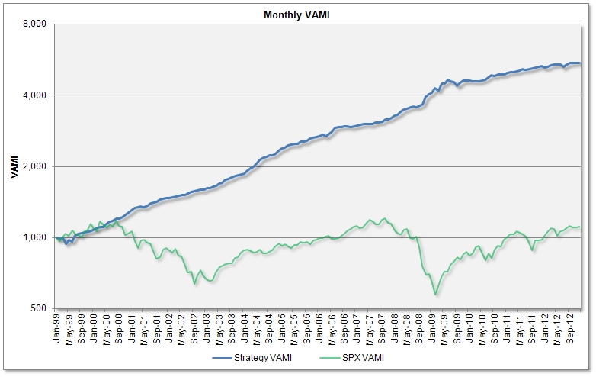
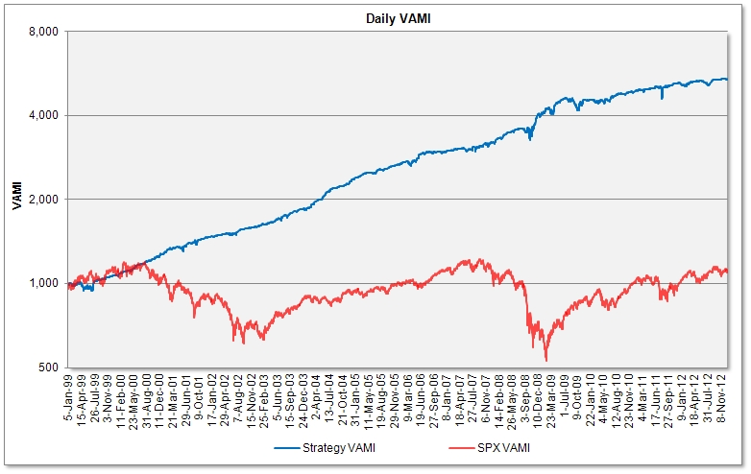
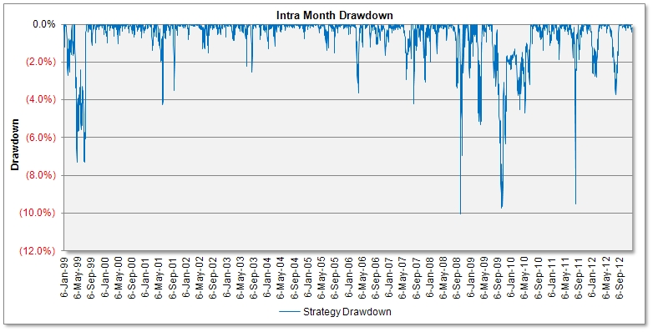
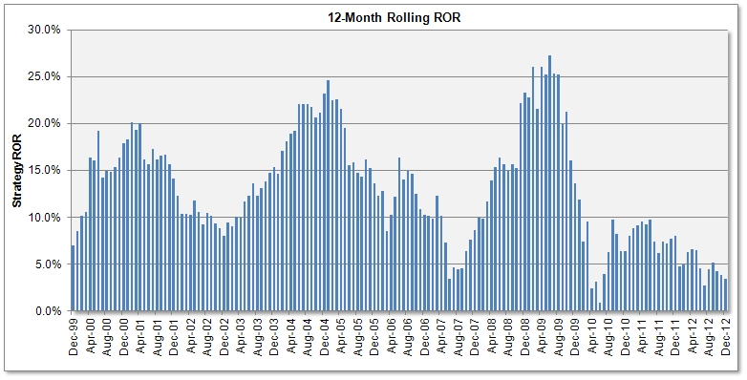
Strategy #2: FX Basket Quant – Back Testing Results
HYPOTHETICAL OR SIMULATED PERFORMANCE RESULTS HAVE CERTAIN INHERENT LIMITATIONS. UNLIKE AN ACTUAL PERFORMANCE RECORD, SIMULATED RESULTS DO NOT REPRESENT ACTUAL TRADING. ALSO, SINCE THE TRADES HAVE NOT ACTUALLY BEEN EXECUTED, THE RESULTS MAY HAVE UNDER-OR-OVERCOMPENSATED FOR THE IMPACT, IF ANY, OF CERTAIN MARKET FACTORS, SUCH AS LACK OF LIQUIDITY. SIMULATED TRADING PLATFORMS IN GENERAL ARE ALSO SUBJECT TO THE FACT THAT THEY ARE DESIGNED WITH THE BENEFIT OF HINDSIGHT. NO REPRESENTATION IS BEING MADE THAT ANY ACCOUNT WILL OR IS LIKELY TO ACHIEVE PROFITS OR LOSSES SIMILAR TO THOSE SHOWN.
For more detailed back testing report please visit www.fx-quant.com/FXBQ/BackTestFXBQ.htm

Slide 16
Strategy #3: FX Quant 11 – Currency Trading Program (FXQ11)
The Strategy
- FXQ11 is based on time series analysis of currency price returns.
- Trades currencies in the cash ("spot") markets. Creates a complex portfolio of 9 global currencies and adjusts its components daily.
- The strategy generates signals based on combinations of 3-th class of all available currency pairs based on the 9 base currencies (NZD, CAD, GBP, EUR, CHF, NOK, SEK, AUD and SGD). For example, one such combination can be NZDCAD+GBPNOK+CHFAUD. The total number of these artificially created trading instruments, is 7140. The mathematics of portfolio diversification show diversification of instruments can lead to better risk-rewards for the combined portfolio.
- In some instruments sells on price increase (buys on price decrease). Do not allow excessive position loading. In some instruments buys double size on price retracement (sells on price rally). The objective is to unload positions in the entire portfolio more rapidly than loading. These opposing forces make the portfolio leverage oscillate around its long term average.
- The system is non-parametric (it has zero degrees of freedom), i.e. there are no parameters to optimize (other than average and maximum leverage).
- Due to the excellent diversification, the combined leverage (the value of all currencies held long, against those held short, relative to NAV - Net Asset Value) oscillates around its mean of 0.66 and rarely reach the maximum of 2.0 (this is another important system's feature).
- Our numerical simulations show that in long run, and if a reasonably high average leverage is used, the profit-to-loss ratio of the FXQ system will be greater than unity (the sum of gains will be greater than the sum of losses). However, as with any trading strategy, drawdowns do exist.
Profit Generation Process
- Each currency pair, depending on its portfolio weight and its daily price return, has a contribution to strategy daily rate of return (ROR).
- Some positions will produce positive and some will produce negative rates of return.
- The strategy, through active portfolio composition and adjustment, attempts to generate positive returns over time.
- The strategy is in the market 100% of time and daily rates of return are calculated on a mark-to-market basis.

Slide 17
Strategy #3: FX Quant 11 – Cont’d
Strategy Leverage
- Leverage is defined as a ratio between the USD value of long portfolio components and the trading size (NAV)
- The average combined leverage is around 0.66 and the maximum leverage should not exceed 2.0.
- The maximum margin-to-equity ratio should not exceed 5% (if margin requirement for a 100,000 currency lot is $1,000).
Risk Control
- Is achieved through a variety of means which in most market conditions should minimize drawdowns
- The first is portfolio construction and diversification (trend and counter trend trading in indexes and their components)
- The second is portfolio concentration control through position size limitation of the 7140 artificially created instruments. Currently set to 8% relative to the account trading size (NAV). Also, the maximum leverage on portfolio level is limited to 200% of NAV.
- Third is catastrophic stop based on money management rules (can be set by the investor)
The strategy was completely redesigned in December 2012.
Please see FX Quant 11 Back Testing Results of v.12/2012.
The newer version started live trading in January 2013.
To Table of Contents

Slide 18
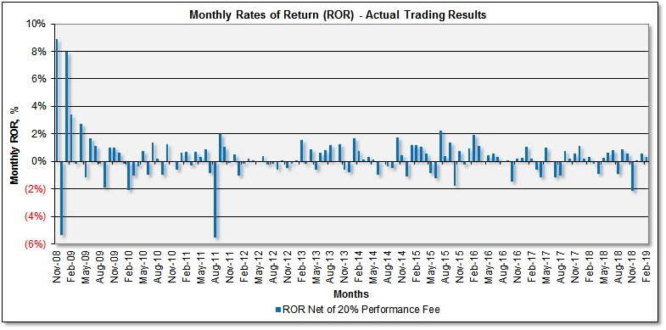
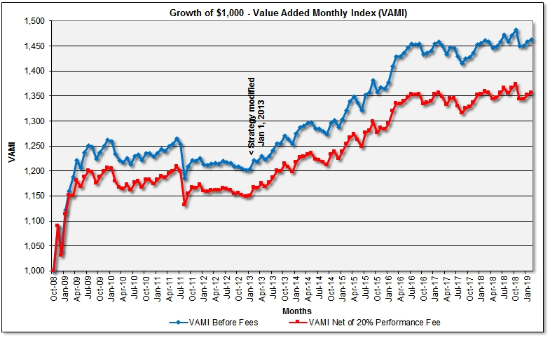
Strategy #3: FX Quant 11 – Performance Summary (Real Trading)
PAST PERFORMANCE IS NOT NECESSARILY INDICATIVE OF FUTURE RESULTS
 | Jan | Feb | Mar | Apr | May | Jun | Jul | Aug | Sep | Oct | Nov | Dec | YTD | VAMI
2008 | See back testing results of the currently traded strategy (v.12/2012) |  |  |  |  |  |  |  |  |  | 8.91% | (5.33%)* | 3.10%* | 1,031.0*
2009 | 8.00% | 3.42% | (0.14%)* | 2.75% | (1.18%) | 1.69%* | 1.11% | (0.18%) | (1.88%)* | 1.01% | 0.98% | 0.61%* | 17.03%* | 1,206.6*
2010 | (0.16%) | (2.05%) | (1.05%)* | (0.35%) | 0.73% | (0.97%)* | 1.37% | 0.23% | (0.99%)* | 1.22% | (0.02%) | (0.62%)* | (2.68%)* | 1,174.3*
2011 | 0.64% | 0.67% | (0.31%)* | 0.70% | 0.35% | 0.87%* | (0.86%) | (5.53%) | 1.98%* | 1.05% | (0.09%) | 0.53%* | (0.20%)* | 1,172.0*
2012 | (1.04%) | (0.15%) | 0.21%* | 0.10% | (0.03%) | 0.41%* | (0.22%) | (0.16%) | (0.58%)* | 0.11%* | (0.45%) | (0.18%)* | (1.98%)* | 1,148.8*
2013 | 0.06% | 1.56% | (0.17%)* | 0.87% | (0.58%) | 0.63%* | 0.83% | 1.20% | (0.05%)* | 1.28% | (0.60%) | (0.76%)* | 4.31%* | 1,198.2
2014 | 1.65%* | 0.77%* | 0.14%* | 0.35%* | 0.15%* | (1.00%)* | (0.06%)* | (0.34%)* | (0.51%)* | 1.74%* | 0.44%* | (1.22%)* | 2.18%* | 1,224.3*
2015 | 1.19%* | 1.17%* | 1.06%* | 0.55%* | (0.85%)* | (1.19%)* | 2.26%* | 0.39%* | 1.37%* | (1.76%)* | 0.79%* | (0.24%)* | 4.76%* | 1,282.7*
2016 | 0.97%* | 1.90%* | 1.13%* | (0.02%)* | 0.43%* | 0.59%* | 0.35%* | (0.04%)* | 0.09%* | (1.48%)* | 0.22%* | 0.27%* | 4.45%* | 1,339.7*
2017 | 1.04%* | 0.20%* | (0.59%)* | (1.17%)* | 0.99%* | (0.06%)* | (1.14%)* | (1.02%)* | 0.74%* | 0.19%* | 0.60%* | 1.15%* | 0.87%* | 1,351.3*
2018 | 0.19%* | 0.33%* | (0.14%)* | (0.92%)* | 0.23%* | 0.65%* | 0.79%* | (0.90%)* | 0.86%* | 0.56%* | (2.14%)* | 0.01%* | (0.53%)* | 1,344.2*
2019 | 0.57%* | 0.31%* |  |  |  |  |  |  |  |  |  |  | 0.88%* | 1,356.0*
For current, more detailed performance report and performance analytics please visit
www.fx-quant.com/FXQ/PerformanceFXQ.htm The strategy was modified in Dec/2012
* Net of 20% performance fee
- Former version of FXQ11

Slide 19
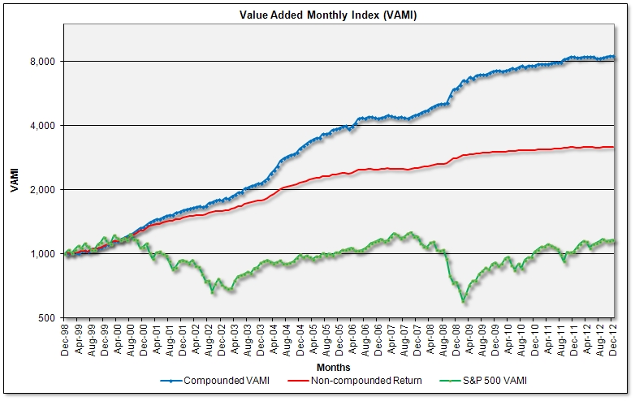
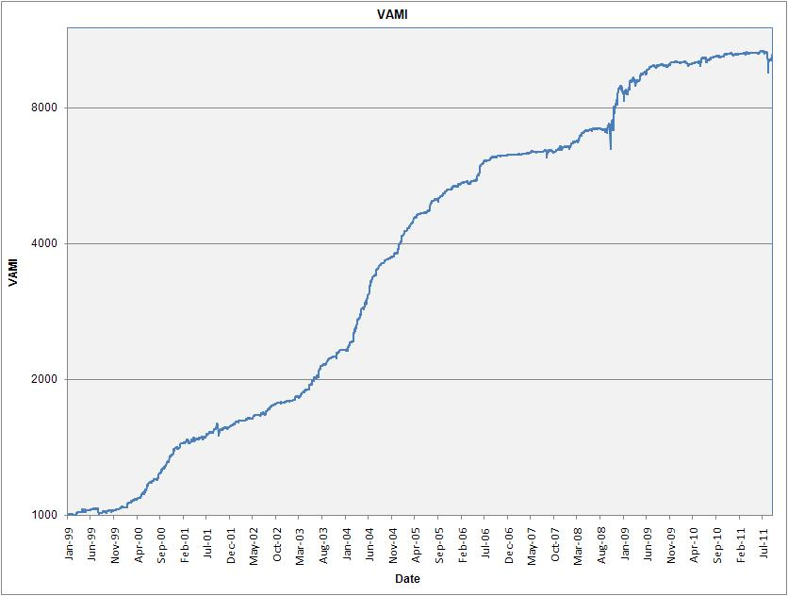
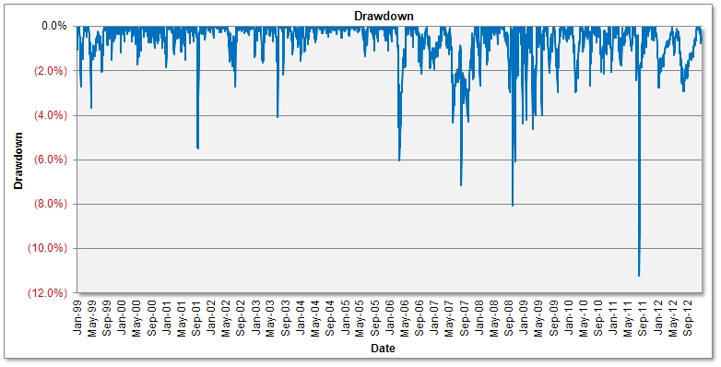
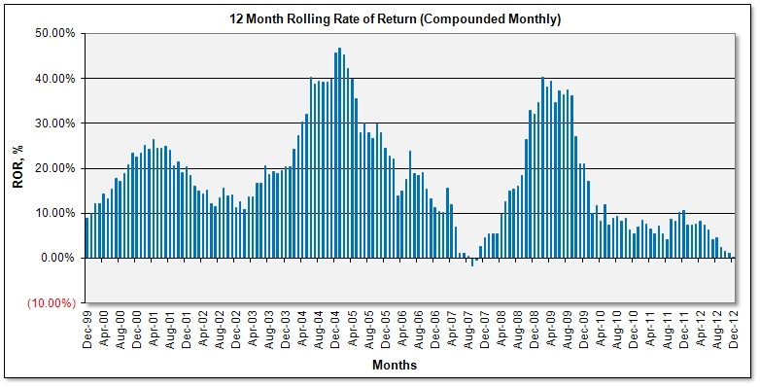
Strategy #3: FX Quant 11 – Back Testing Results (Ver.12/2012)
This version of the strategy replaced the former one and started live trading in January 2013.
HYPOTHETICAL OR SIMULATED PERFORMANCE RESULTS HAVE CERTAIN INHERENT LIMITATIONS. UNLIKE AN ACTUAL PERFORMANCE RECORD, SIMULATED RESULTS DO NOT REPRESENT ACTUAL TRADING. ALSO, SINCE THE TRADES HAVE NOT ACTUALLY BEEN EXECUTED, THE RESULTS MAY HAVE UNDER-OR-OVERCOMPENSATED FOR THE IMPACT, IF ANY, OF CERTAIN MARKET FACTORS, SUCH AS LACK OF LIQUIDITY. SIMULATED TRADING PLATFORMS IN GENERAL ARE ALSO SUBJECT TO THE FACT THAT THEY ARE DESIGNED WITH THE BENEFIT OF HINDSIGHT. NO REPRESENTATION IS BEING MADE THAT ANY ACCOUNT WILL OR IS LIKELY TO ACHIEVE PROFITS OR LOSSES SIMILAR TO THOSE SHOWN.
For more detailed back testing report please visit www.fx-quant.com/FXQ/BackTesting-FxQuant11.htm

Slide 20
Strategy #4: FXC – Currency Trading Program
The Strategy
FXC (or FX Index Arb - Continuous) is a modification of the FX Index Arb trading strategy, which trades automatically 3-4 times a day. There is a special order placement procedure, which places the trades on negative slippage (i.e. with additional profit), or signals are recalculated and the basket trade is placed again. This increases the risk adjusted profitability (the Profit to Loss Ratio and Sharpe Ratio). Although the order placement generates some risk free profit, the price that we pay for it is taking the risk of trading the FXIA strategy itself. Since it is virtually impossible to back test the FXC performance, the strategy has been traded for a while on the MT4 simulation trading platform before going live.
Strategy Execution
- The entire process of calculation, order placement and error reporting is automated, without human intervention.
- The program runs on a managed remote Cloud server with multiple (redundant) Internet connections. The Cloud server is self-healing, i.e. which prevents loss of data.
- The combined leverage is limited to 2.0, in order to prevent disastrous drawdowns in case of trading infrastructure failure.
Risk control is achieved through a variety of means which in most market conditions should minimize drawdowns. The first is leverage control; second is periodical system check and automatic error reporting; and third is discretionary stop based on money management rules.

Slide 21
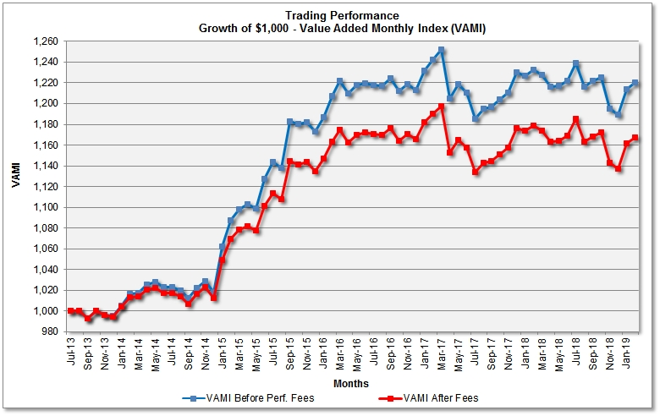
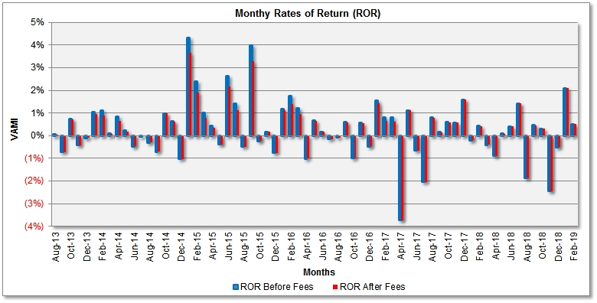
Strategy #4: FXC – Perf. Summary (Real Trading)
PAST PERFORMANCE IS NOT NECESSARILY INDICATIVE OF FUTURE RESULTS
 | Jan | Feb | Mar | Apr | May | Jun | Jul | Aug | Sep | Oct | Nov | Dec | YTD | VAMI
2013 | See simulated trading results of the current strategy |  |  |  |  |  |  | 0.04%* | (0.74%)* | 0.72%* | (0.42%)* | (0.10%)* | (0.40%)* | 994.9*
2014 | 0.95%* | 0.88%* | 0.07%* | 0.66%* | 0.18%* | (0.47%)* | (0.04%)* | (0.30%)* | (0.71%)* | 0.99%* | 0.60%* | (1.03%)* | 1.76%* | 1,012.4*
2015 | 3.67%* | 1.92%* | 0.80%* | 0.34%* | (0.39%)* | 2.17%* | 1.13%* | (0.49%)* | 3.27%* | (0.23%)* | 0.17%* | (0.76%)* | 12.08%* | 1,134.8*
2016 | 1.11%* | 1.39%* | 0.97%* | (1.02%)* | 0.66%* | 0.18%* | (0.15%)* | (0.09%)* | 0.57%* | (1.00%)* | 0.56%* | (0.47%)* | 2.71%* | 1,165.5*
2017 | 1.43%* | 0.65%* | 0.63%* | (3.74%)* | 1.11%* | (0.66%)* | (2.04%)* | 0.80%* | 0.15%* | 0.58%* | 0.57%* | 1.58%* | 0.93%* | 1,176.3*
2018 | (0.21%)* | 0.42%* | (0.40%)* | (0.90%)* | 0.09%* | 0.40%* | 1.42%* | (1.87%)* | 0.45%* | 0.30%* | (2.45%)* | (0.50%)* | (3.29%)* | 1,137.6*
2019 | 2.09%* | 0.50%* |  |  |  |  |  |  |  |  |  |  | 2.60%* | 1,167.2*
For current, more detailed performance report and performance analytics please visit
www.fx-quant.com/FXC/PerformanceFXC.htm
* Net of 20% performance fee
To Table of Contents

Slide 22
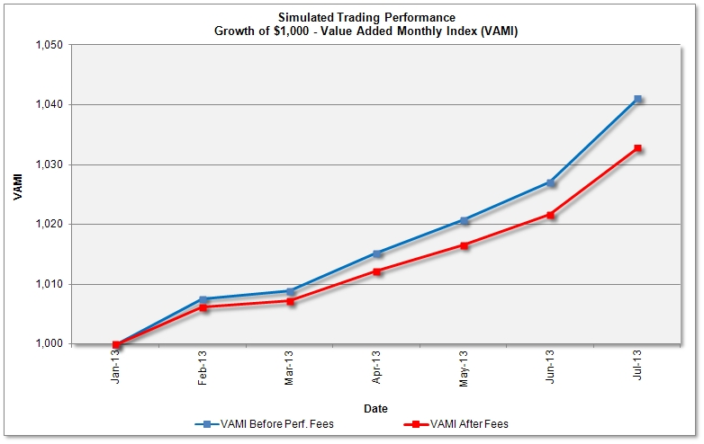
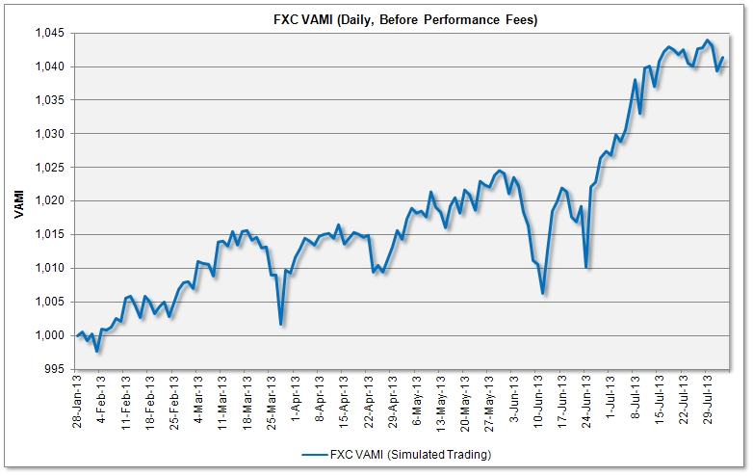
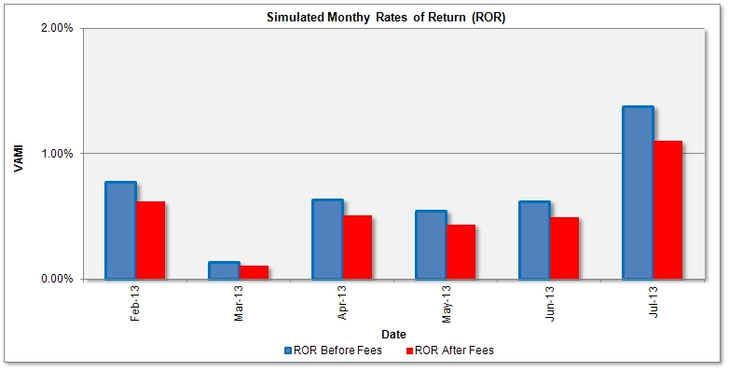
Strategy #4: FXC – Simulated Trading Results
HYPOTHETICAL OR SIMULATED PERFORMANCE RESULTS HAVE CERTAIN INHERENT LIMITATIONS. UNLIKE AN ACTUAL PERFORMANCE RECORD, SIMULATED RESULTS DO NOT REPRESENT ACTUAL TRADING. ALSO, SINCE THE TRADES HAVE NOT ACTUALLY BEEN EXECUTED, THE RESULTS MAY HAVE UNDER-OR-OVERCOMPENSATED FOR THE IMPACT, IF ANY, OF CERTAIN MARKET FACTORS, SUCH AS LACK OF LIQUIDITY. SIMULATED TRADING PLATFORMS IN GENERAL ARE ALSO SUBJECT TO THE FACT THAT THEY ARE DESIGNED WITH THE BENEFIT OF HINDSIGHT. NO REPRESENTATION IS BEING MADE THAT ANY ACCOUNT WILL OR IS LIKELY TO ACHIEVE PROFITS OR LOSSES SIMILAR TO THOSE SHOWN.
For more detailed back testing report please visit www.fx-quant.com/FXC/FXC-Simulated.htm

Slide 23
Strategy #5: V1 – Volatility Trading Program
The Strategy
V1 is basically a market neutral, S&P 500 volatility (VIX) arbitrage trading strategy.
It exploits the term structure (contango and backwardation) of the VIX futures premium.
- The strategy uses time series analysis and does not use classical fundamental or technical analysis.
The strategy can either trade iPath's S&P 500 VIX short/mid term futures ETNs - VXX, VXZ (preferred trading instruments) or S&P 500 VIX futures and/or options.
V1 adjusts portfolio components on daily basis. The combined net leverage (long and short positions leverage) is less than 0.6, i.e. the strategy is underleveraged, in order to prevent disastrous drawdowns from overleveraged trading.
- Strategy returns are weakly correlated with S&P 500 index returns. Since the strategy is not correlated to swing and trend following strategies, it can be seen as a good complement to them.
Profit Generation Process
- Basically, V1 is a pair trading, VXZ/VXX long/short trading strategy, where VXX is an ETN (exchange traded note) which consists of VIX futures of front VIX months and VXZ is ETN which consists of VIX futures of more distant months.
- The strategy aims to profit from contango, when the premium in front months VIX futures is lower than premium in more distant months futures. In this mode, the strategy is dominantly short VXX ETNs, relative to VXZ.
- On the other hand, and less frequently, when VIX futures trade in backwardation, the strategy attempts to profit from holding dominantly long position of VXZ relative to VXX.
- The hedge ratio is variable and depends on the VIX premium term structure.
- Each portfolio component, depending on its portfolio weight and its daily price return, has a contribution to strategy daily rate of return (ROR). The strategy, through active portfolio adjustments, attempts to generate positive returns over time.
- The strategy is in the market 100% of time and daily rates of return are calculated on a mark-to-market basis.

Slide 24
Strategy #5: V1 – Cont’d
Strategy Leverage
- The leverage on the long, VXZ side is normally set to 0.3, while on the short, VXX side, the leverage is variable from 0.1 to 0.3, relative to trading size (NAV)
- The maximum margin-to-equity ratio should not exceed 30% (if the overnight margin requirement is 50% for the VXX/VXZ ETNs)
Risk Control
- Is achieved through a variety of means which in most market conditions should minimize drawdowns
- The first is portfolio construction and long/short leverage limitation;
- Second is dynamic hedge ratio adjustment. Instead of classical stop loss orders, the hedge ratio is changed intraday. This means, if volatility spikes intraday the short VXX position will be reduced, relative to VXZ. On declining volatility the VXX position is relatively increased. Positions are also adjusted at the end of the trading day, at NY close.
- Third is catastrophic stop based on money management rules (can be set by the investor).
To Table of Contents

Slide 25
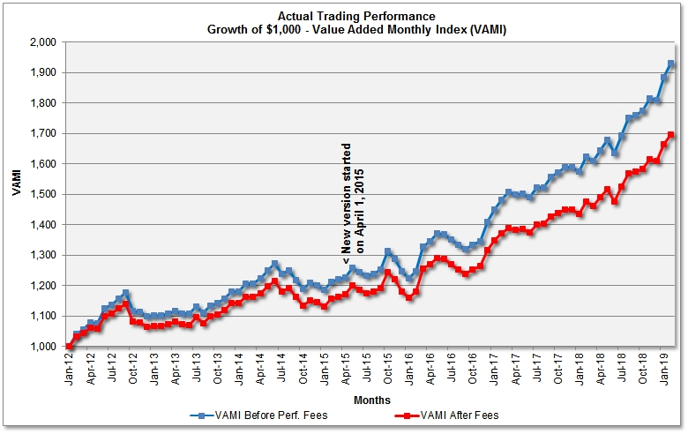
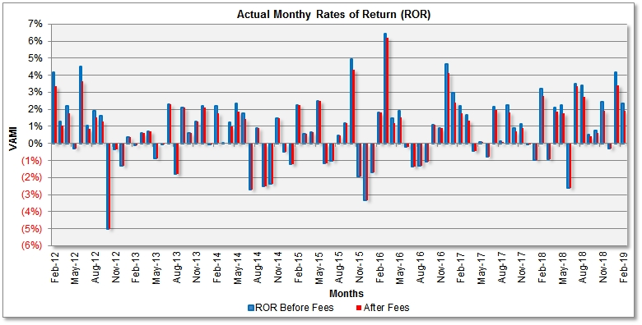
Strategy #5: V1 – Performance Summary (Real Trading)
PAST PERFORMANCE IS NOT NECESSARILY INDICATIVE OF FUTURE RESULTS
 | Jan | Feb | Mar | Apr | May | Jun | Jul | Aug | Sep | Oct | Nov | Dec | YTD | VAMI
2011 | See back testing results of the currently traded strategy (v.03/2015) |  |  |  |  |  |  |  |  |  |  |  | - | 1,000.0*
2012 | - | 3.34%* | 1.03%* | 1.75%* | (0.28%)* | 3.65%* | 0.85%* | 1.53%* | 1.29%* | (5.00%)* | (0.33%)* | (1.33%)* | 6.42%* | 1,064.2*
2013 | 0.37%* | (0.10%)* | 0.61%* | 0.73%* | (0.89%)* | (0.05%)* | 2.28%* | (1.78%)* | 2.11%* | 0.60%* | 1.28%* | 2.09%* | 7.42%* | 1,143.1*
2014 | (0.04%)* | 1.77%* | 0.02%* | 0.99%* | 1.87%* | 1.43%* | (2.71%)* | 0.90%* | (2.49%)* | (2.37%)* | 1.50%* | (0.50%)* | 0.21%* | 1,145.5*
2015 | (1.24%)* | 2.23%* | 0.55%* | 0.65%* | 2.48%* | (1.16%)* | (1.04%)* | 0.48%* | 1.18%* | 4.33%* | (1.93%)* | (3.32%)* | 3.01%* | 1,180.1*
2016 | (1.68%)* | 1.80%* | 6.22%* | 1.20%* | 1.54%* | (0.19%)* | (1.36%)* | (1.30%)* | (1.09%)* | 1.09%* | 0.91%* | 4.14%* | 11.55%* | 1,316.3*
2017 | 2.37%* | 1.75%* | 1.34%* | (0.42%)* | 0.08%* | (0.80%)* | 1.97%* | 0.10%* | 1.81%* | 0.71%* | 0.90%* | (0.02%)* | 10.17%* | 1,450.1*
2018 | (0.97%)* | 2.74%* | (0.92%)* | 1.86%* | 1.79%* | (2.63%)* | 3.35%* | 2.72%* | 0.40%* | 0.61%* | 1.94%* | (0.30%)* | 10.96%* | 1,609.1*
2019 | 3.39%* | 1.90%* |  |  |  |  |  |  |  |  |  |  | 5.35%* | 1,695.2*
For current, more detailed performance report and performance analytics please visit
http://www.vol-quant.com/V1/PerformanceV1.htm
* Net of 20% performance fee
- Former version of V1

Slide 26
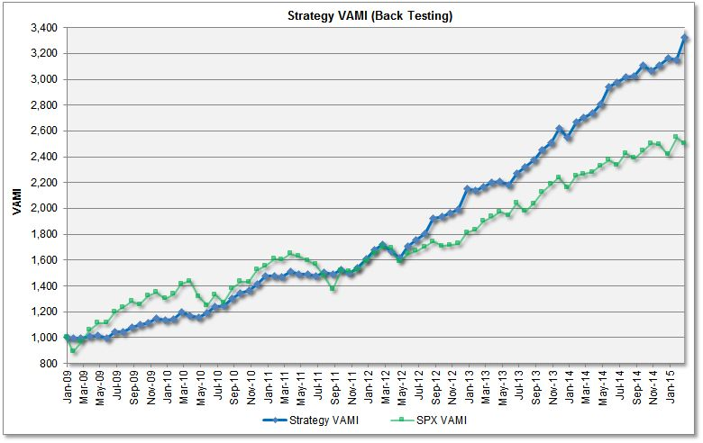
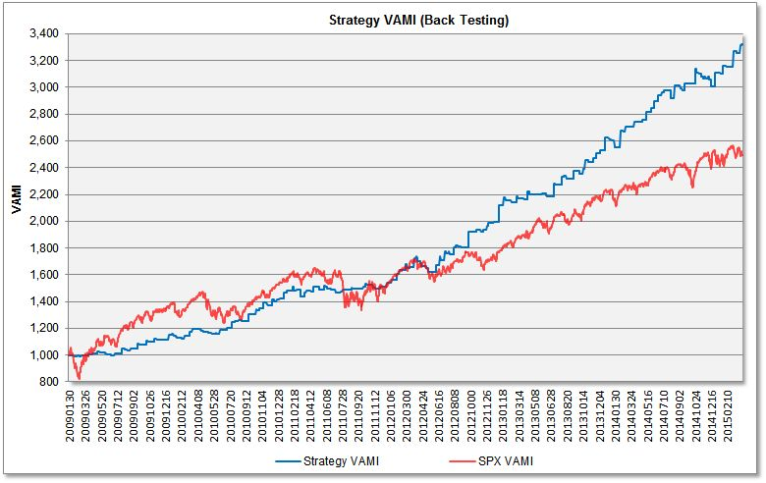
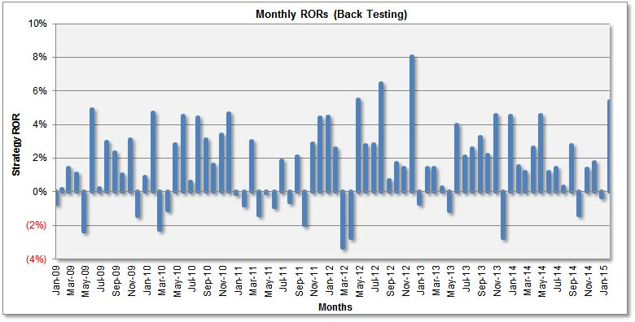
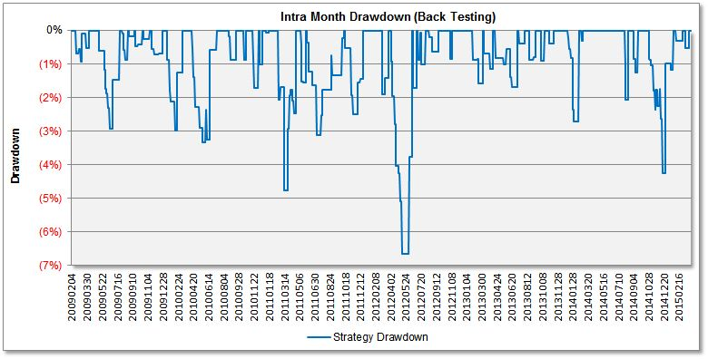
Strategy #5: V1 – Back Testing Results
HYPOTHETICAL OR SIMULATED PERFORMANCE RESULTS HAVE CERTAIN INHERENT LIMITATIONS. UNLIKE AN ACTUAL PERFORMANCE RECORD, SIMULATED RESULTS DO NOT REPRESENT ACTUAL TRADING. ALSO, SINCE THE TRADES HAVE NOT ACTUALLY BEEN EXECUTED, THE RESULTS MAY HAVE UNDER-OR-OVERCOMPENSATED FOR THE IMPACT, IF ANY, OF CERTAIN MARKET FACTORS, SUCH AS LACK OF LIQUIDITY. SIMULATED TRADING PLATFORMS IN GENERAL ARE ALSO SUBJECT TO THE FACT THAT THEY ARE DESIGNED WITH THE BENEFIT OF HINDSIGHT. NO REPRESENTATION IS BEING MADE THAT ANY ACCOUNT WILL OR IS LIKELY TO ACHIEVE PROFITS OR LOSSES SIMILAR TO THOSE SHOWN.
For more detailed back testing reports please visit www.vol-quant.com/V1/V1backtesting.htm

Slide 27
Strategy #6: SP Quant – S&P 500 IndexTrading Program (SPQ)
The Strategy
SPQ is premium collecting S&P 500 options trading strategy.
It exploits the gradual time premium decay in S&P 500 ETF (SPY) options.
The strategy holds short puts and hedges them with short SPY stocks.
The strategy trades 0-5 times a day using a proprietary risk hedging technique.
The combined net position delta is kept less than 0.5 at all times.
- Strategy returns are weekly positively correlated with S&P 500 index returns.
Profit Generation Process
- Basically, SPQ is a premium collecting SY options trading strategy on SPY options. The hedged position delta is negative most of the time, although in downward moving market it can become positive.
- The strategy aims to profit from the gradual time premium decay in options and also from the hedge.
- The hedge ratio is variable and depends on distance from the option strike price.
- Each portfolio component, depending on its portfolio weight and its daily price return, has a contribution to strategy’s daily rate of return (ROR). The strategy, through active portfolio adjustments, attempts to generate positive returns over time.
- The strategy is in the market 100% of time and daily rates of return are calculated on a mark-to-market basis.

Slide 28
Strategy #6: SPQ – Cont’d
Strategy Leverage
- In a standard, Reg-T margin account, the total leverage should not exceed 0.5 of account nominal trading size (account NAV). We trade and report the performance based on this standard account setup.
- For accounts with NAV above $110,000, Interactive Brokers allows portfolio margin, enabling higher leverage and profitability, which, of course, comes along with increased risks.
Risk Control
- Is achieved through a variety of means which in most market conditions should minimize drawdowns
- The first is portfolio construction, making the portfolio as little sensitive to underlying instruments price fluctuations as possible;
- Second is dynamic hedge ratio adjustment. Positions are usually adjusted during the trading day, by stop orders in SPY stocks. In case of huge price moves of the underlying stock (SPY) options are rolled over to lower strike prices.
- Third is catastrophic stop based on money management rules (can be set by the investor).
To Table of Contents

Slide 29
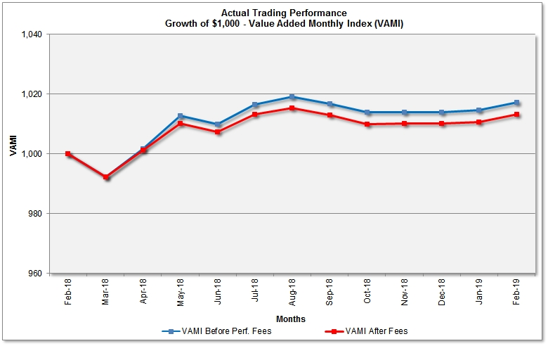
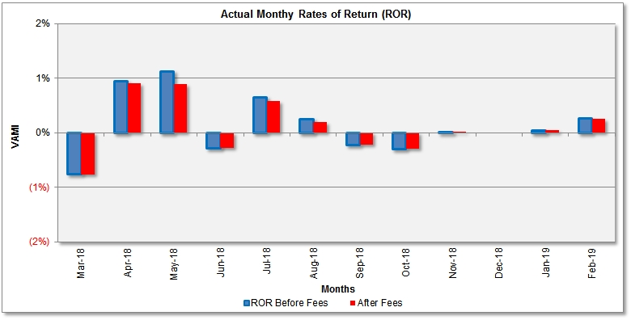
Strategy #6: SPQ – Performance Summary (Real Trading)
PAST PERFORMANCE IS NOT NECESSARILY INDICATIVE OF FUTURE RESULTS
 | Jan | Feb | Mar | Apr | May | Jun | Jul | Aug | Sep | Oct | Nov | Dec | YTD | VAMI
2019 | 0.05% 0.05%* | 0.26% 0.26%* |  |  |  |  |  |  |  |  |  |  | 0.31% 0.31%* | 1,003.1 1,003.1*
* Net of 20% performance fee
The strategy was modified in January 2019. For current, more detailed performance report and performance analytics please visit http://equity-quant.com/SP-Quant/PerformanceSPQ.htm

Slide 30
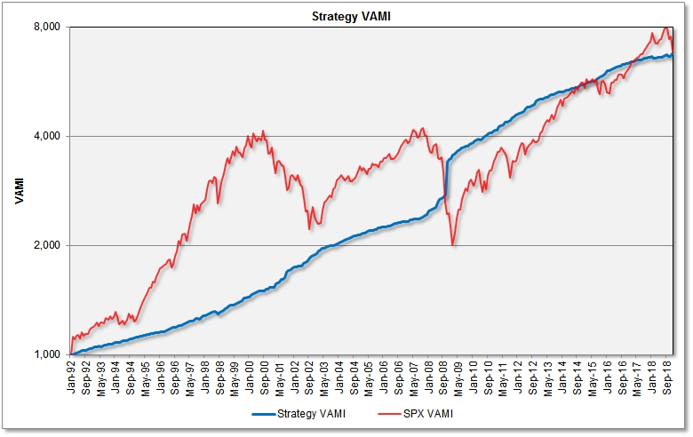
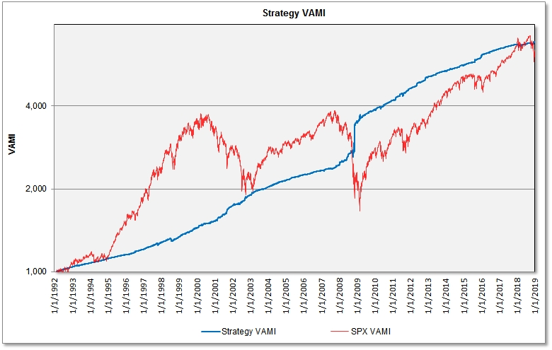
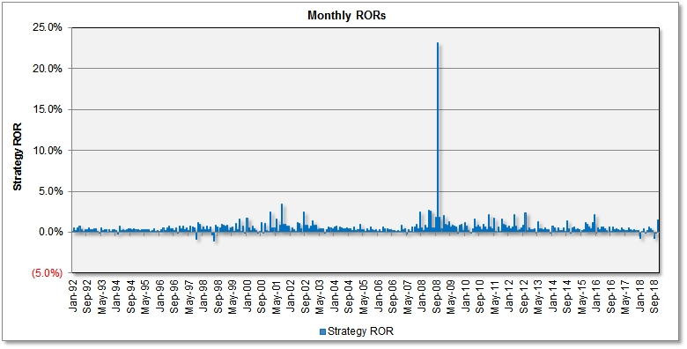
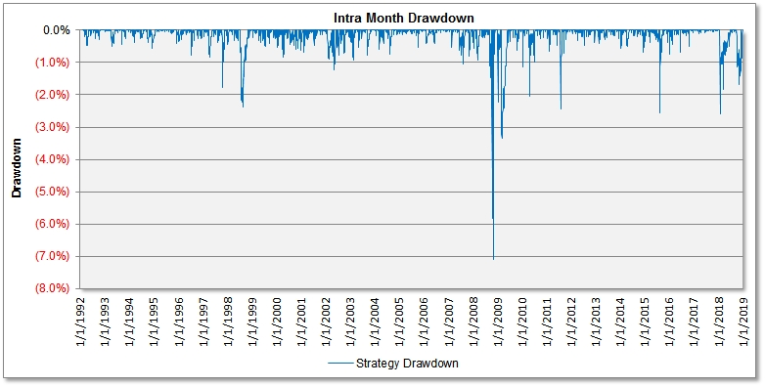
Strategy #6: SPQ – Back Testing Results
HYPOTHETICAL OR SIMULATED PERFORMANCE RESULTS HAVE CERTAIN INHERENT LIMITATIONS. UNLIKE AN ACTUAL PERFORMANCE RECORD, SIMULATED RESULTS DO NOT REPRESENT ACTUAL TRADING. ALSO, SINCE THE TRADES HAVE NOT ACTUALLY BEEN EXECUTED, THE RESULTS MAY HAVE UNDER-OR-OVERCOMPENSATED FOR THE IMPACT, IF ANY, OF CERTAIN MARKET FACTORS, SUCH AS LACK OF LIQUIDITY. SIMULATED TRADING PLATFORMS IN GENERAL ARE ALSO SUBJECT TO THE FACT THAT THEY ARE DESIGNED WITH THE BENEFIT OF HINDSIGHT. NO REPRESENTATION IS BEING MADE THAT ANY ACCOUNT WILL OR IS LIKELY TO ACHIEVE PROFITS OR LOSSES SIMILAR TO THOSE SHOWN.
For more detailed back testing reports please visit www.equity-quant.com/SPQ/Backtesting-SPQ.htm

Slide 31
Strategy #7: V4 – Volatility Trading Program
The Strategy
V4 is a directional - trend following, S&P 500 volatility (VIX) trading strategy.
It exploits the downward trend persistence of the VXXB ETNs and CFDs.
- The strategy is an ETN replication of an option trading strategy (the latest version of the strategy, v.12.2018)
The strategy can either trade iPath's S&P 500 VIX short term futures ETNs or CFDs – symbol VXXB (preferred trading instruments). Alternatively, VXXB futures and/or options can be traded (with lower efficiency).
V4 trades intraday and at market close. The leverage is low and constant (0.00-0.30), i.e. the strategy is underleveraged, in order to prevent disastrous drawdowns from overleveraged trading.
Strategy returns are moderately correlated with S&P 500 index returns.
More detailed strategy description (ver. 12/2018) can be found at www.vol-quant.com/V3/Backtesting-V3.htm
Profit Generation Process
- The strategy is short VXXB with variable exposure. There are also protective intra-day stops.
- Positions are adjusted daily, around market close.
- The strategy aims to profit from contango, when the premium in front months VIX futures is lower than premium in more distant months futures. In this mode, the strategy is short VXXB ETNs.
- When VIX futures trade in backwardation, the strategy decreases the short exposure.
- The strategy is in the market nearly 100% of the time and daily rates of return are calculated on a mark-to-market basis.

Slide 32
Strategy #7: V4 – Cont’d
Strategy Leverage
- The leverage on the short VXX position is normally set to 0.15-0.3. The strategy adds to a winning position.
- The maximum margin-to-equity ratio should not exceed 15% (if the overnight margin requirement is 50% for the VXX ETNs)
Risk Control
- Is achieved through a variety of means which in most market conditions should minimize drawdowns
- The first is leverage limitation;
- Second is through the use of intraday stop loss orders. This means, if volatility spikes intraday the short VXX position will be reduced, or liquidated. On declining volatility the VXX position is relatively increased. Positions may also be adjusted at the end of the trading day, at NY close.
- Third is catastrophic stop based on money management rules (can be set by the investor).
To Table of Contents

Slide 33
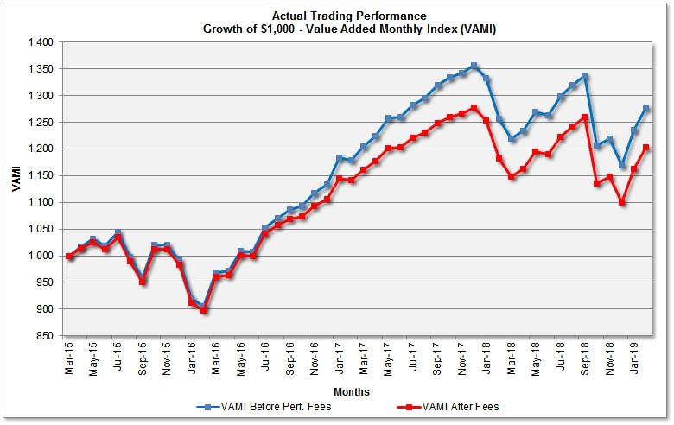
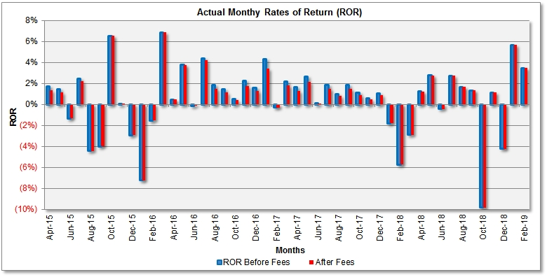
Strategy #7: V4 – Performance Summary (Real Trading)
PAST PERFORMANCE IS NOT NECESSARILY INDICATIVE OF FUTURE RESULTS
 | Jan | Feb | Mar | Apr | May | Jun | Jul | Aug | Sep | Oct | Nov | Dec | YTD | VAMI
2015 |  |  |  | 1.74%* | 1.47%* | (1.31%)* | 2.48%* | (4.41%)* | (3.98%)* | 6.55%* | 0.01%* | (2.92%)* | (1.72%)* | 982.8*
2016 | (7.22%)* | (1.54%)* | 6.87%* | 0.48%* | 3.77%* | (0.14%)* | 4.24%* | 1.46%* | 1.15%* | 0.43%* | 1.79%* | 1.26%* | 12.57%* | 1,106.4*
2017 | 3.43%* | (0.30%)* | 1.81%* | 1.31%* | 2.15%* | 0.09%* | 1.51%* | 0.80%* | 1.46%* | 0.87%* | 0.49%* | 0.86%* | 15.41%* | 1,276.9*
2018 | (1.80%)* | (5.71%)* | (2.88%)* | 1.23%* | 2.77%* | (0.42%)* | 2.75%* | 1.66%* | 1.35%* | (9.81%)* | 1.13%* | (4.23%)* | (13.85%)* | 1,100.0*
2019 | 5.68%* | 3.48%* |  |  |  |  |  |  |  |  |  |  | 9.35%* | 1,202.9*
The strategy was modified in December 2018 – see back testing results.
For current, more detailed performance report and performance analytics please visit
http://www.vol-quant.com/V4/PerformanceV4.htm
* Net of 20% performance fee

Slide 34
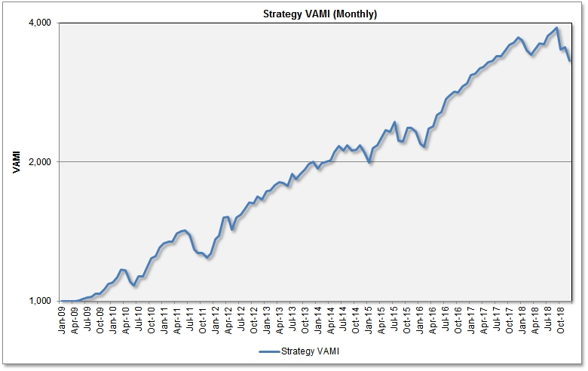
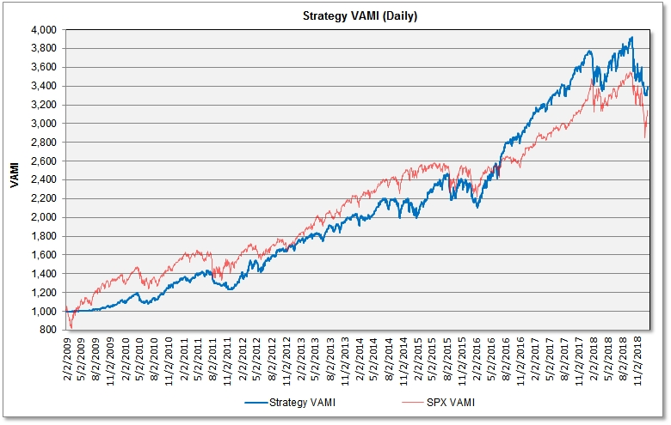
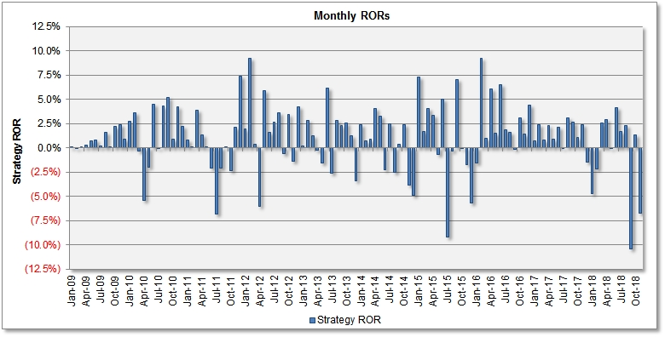
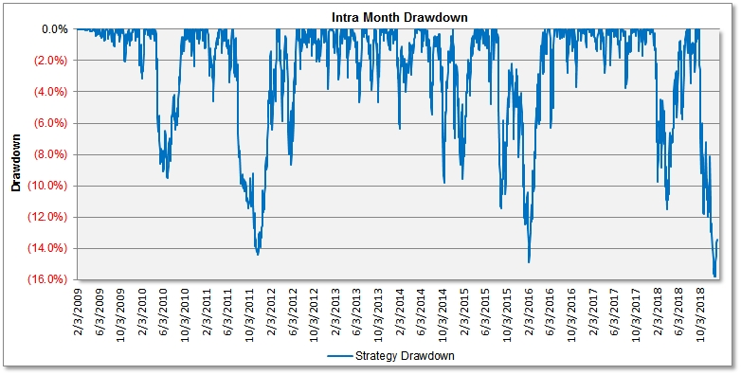
Strategy #7: V4 – Back Testing Results (ver. 12.2018)
HYPOTHETICAL OR SIMULATED PERFORMANCE RESULTS HAVE CERTAIN INHERENT LIMITATIONS. UNLIKE AN ACTUAL PERFORMANCE RECORD, SIMULATED RESULTS DO NOT REPRESENT ACTUAL TRADING. ALSO, SINCE THE TRADES HAVE NOT ACTUALLY BEEN EXECUTED, THE RESULTS MAY HAVE UNDER-OR-OVERCOMPENSATED FOR THE IMPACT, IF ANY, OF CERTAIN MARKET FACTORS, SUCH AS LACK OF LIQUIDITY. SIMULATED TRADING PLATFORMS IN GENERAL ARE ALSO SUBJECT TO THE FACT THAT THEY ARE DESIGNED WITH THE BENEFIT OF HINDSIGHT. NO REPRESENTATION IS BEING MADE THAT ANY ACCOUNT WILL OR IS LIKELY TO ACHIEVE PROFITS OR LOSSES SIMILAR TO THOSE SHOWN.
For more detailed back testing reports and performance analytics please visit www.vol-quant.com/V3/Backtesting-V3.htm

Slide 35
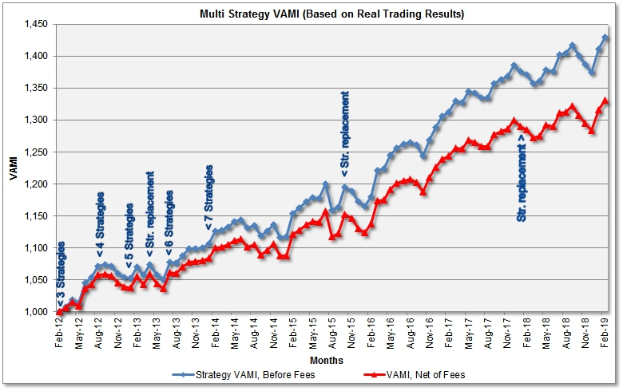
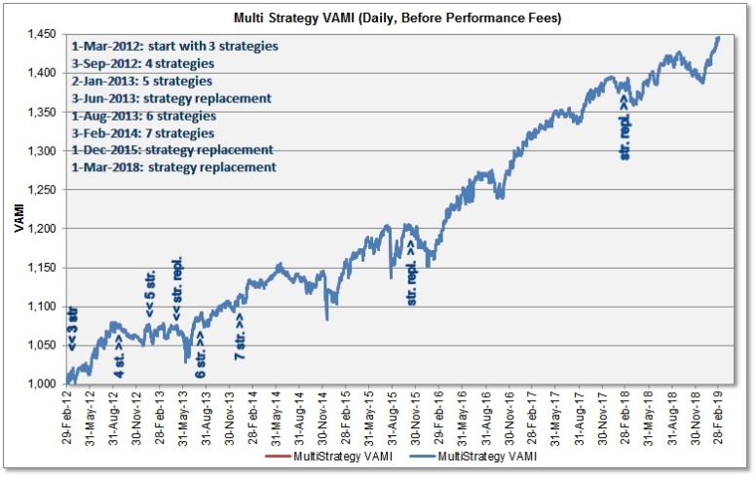
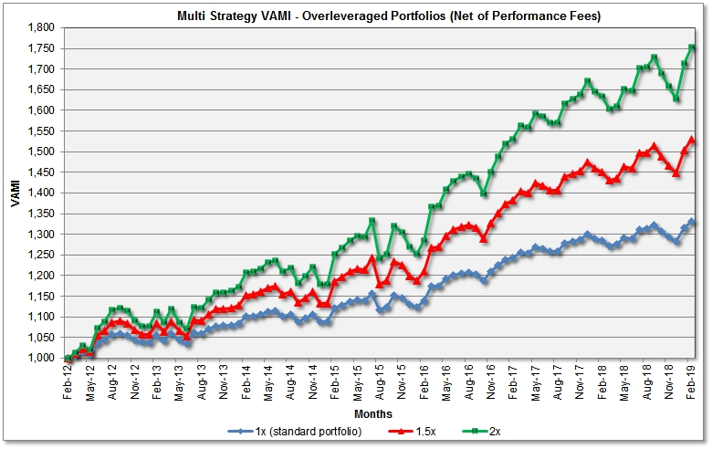
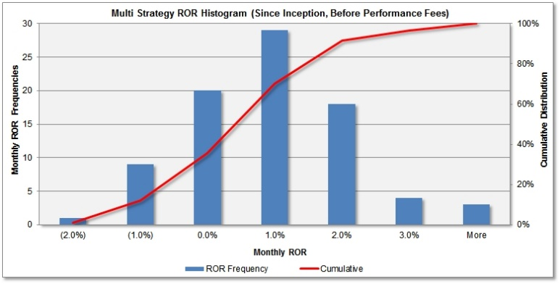
III. Multi Strategy Performance Summary (Real Trading)
PAST PERFORMANCE IS NOT NECESSARILY INDICATIVE OF FUTURE RESULTS
For current, more detailed performance report and performance analytics please visit
http://www.fx-quant.com/MS/MS-real.htm

Slide 36
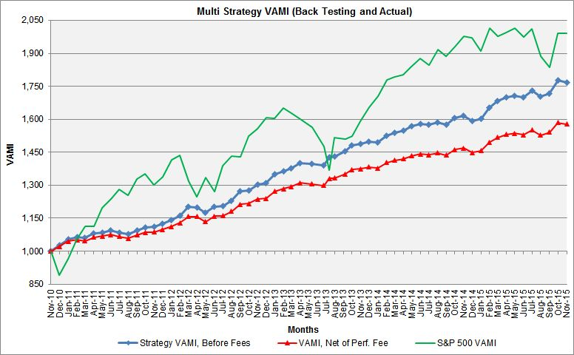
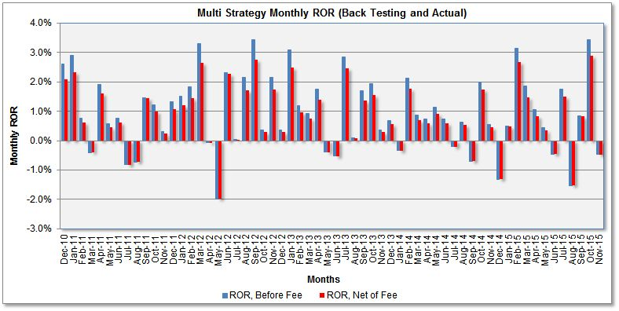
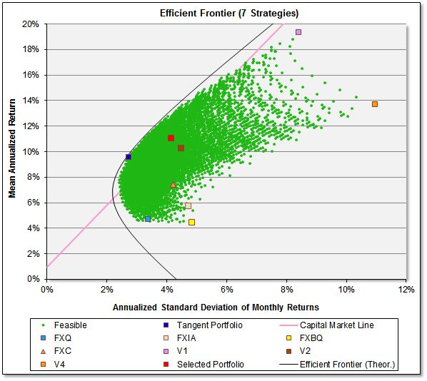
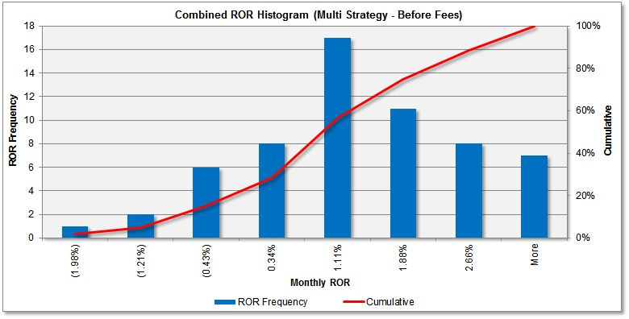
MS7 Multi Strategy - Back Testing (7 Strategies, V.11/2015)
HYPOTHETICAL OR SIMULATED PERFORMANCE RESULTS HAVE CERTAIN INHERENT LIMITATIONS. UNLIKE AN ACTUAL PERFORMANCE RECORD, SIMULATED RESULTS DO NOT REPRESENT ACTUAL TRADING. ALSO, SINCE THE TRADES HAVE NOT ACTUALLY BEEN EXECUTED, THE RESULTS MAY HAVE UNDER-OR-OVERCOMPENSATED FOR THE IMPACT, IF ANY, OF CERTAIN MARKET FACTORS, SUCH AS LACK OF LIQUIDITY. SIMULATED TRADING PLATFORMS IN GENERAL ARE ALSO SUBJECT TO THE FACT THAT THEY ARE DESIGNED WITH THE BENEFIT OF HINDSIGHT. NO REPRESENTATION IS BEING MADE THAT ANY ACCOUNT WILL OR IS LIKELY TO ACHIEVE PROFITS OR LOSSES SIMILAR TO THOSE SHOWN.
For more detailed back testing report please visit http://www.fx-quant.com/MS/MS6-backtesting.htm

Slide 37
IV. Execution and Risk Controls
FX Quant 11, FX Index Arb and FX Basket Quant trade just once a day. Trading on the Metatrader 4 (MT4) trading platform is automated, on a remote Cloud server, using MT4 expert advisors. Trading with other FDMs can be either manual or automatic (Currenex). Reconciliation of trades is performed daily, after the execution of trades.
FXC is traded automatically 24/5 on the MT4 trading platform. The entire process of calculation, order placement and error reporting is automated, without human intervention. The program runs on a managed, remote server with multiple (redundant) Internet connections. The combined leverage is limited to 2, to prevent excessive drawdowns in case of trading infrastructure failure. Despite the automatic error reporting, the server and trading platform are checked manually several times a day.
V1 and V4 are currently traded manually. Trading signals (price levels and position sizes) are calculated and stop/stop-limit orders are placed before market open. Shortly before market close (4 pm EST) signals for V1 are calculated again and, if necessary, market orders are placed. Programs and data are backed-up daily on a Cloud server.
- SPQ is traded manually on the Interactive Broker’s TWS trading platform. It places the orders once a day before NY, which may be activated during the trading session. The performance is monitored intraday in fast moving market. Programs and data are backed-up daily on a Cloud server.
To Table of Contents

Slide 38

V. Key Investment Terms
- 0% Management fee (zero deal) and performance fee of 20% (12% for funds of funds / funds of CTAs) of all trading profits, based on monthly or quarterly high water mark, or upon exit from the Program. See this calculation example in Excel.
- No subscription fees and no withdrawal fees
- No account lock-up period
- Notional funding available. Client may deposit only $250,000 in his trading account, while trading $1,000,000 nominal trading size.
- The account will be in client's own name with Pepperstone Group or Interactive Brokers (the FDM - Forex Dealer Member). Contact us if you want to auto trade with another Forex dealing company
- Under LPOA (Limited Power of Attorney) authorization, Lyncestis LLP can only trade client's account but may not transfer/withdraw any funds from the trading account (the client will choose different passwords for the MT4 trading platform and for the cash management platform).
- The initial investment for separately managed accounts is $100,000 (with Pepperstone Group Australia or other brokers with MT4 trading platform) or $1,000,000 (Interactive Brokers, Newedge or another FDM)
Benefits to Investors
- Real-time account management with reporting in real time
- Full position level and NAV transparency
- Liquidity of assets - money can be withdrawn any time without fees or penalties
- Investment diversification from Forex trading that is not tied to the stock market
- An alternative to bonds and low-yielding instruments like money markets and certificates of deposit, for those who can accept higher risks in exchange for higher potential returns
- Profit potential in any economic environment (in rising, falling and sideways moving market)
- The account traded is based on a quantitative trading system that is completely systematic and free of human influences
- Convenient to clients who want to diversify their investments or just don’t have the time to dedicate to trading

Slide 39
VI. Risk Notice
Alternative investments and separately managed accounts carry a high degree of risk, and may not be suitable for all investors. Before deciding to participate in a separately managed account program you should carefully consider your investment objectives, level of experience, and risk appetite.
There is no assurance that a separately managed account will achieve its investment objective. There is no guarantee that any trading strategy will work under all market conditions, and each investor should evaluate their ability to invest for the long-term, especially during periods of high volatility in the market. Separately managed accounts are subject to market risk, which is the possibility that the market values of assets owned will fluctuate and that the value of the assets may therefore be less than what you paid for them. Accordingly, you can lose money investing in a separately managed account. Please be aware that these strategies may be subject to certain additional risks. The possibility exists that you could sustain a loss of some or all of your initial investment and therefore you should not invest money that you cannot afford to lose.
You should be aware of all the risks associated with separately managed account programs, and seek advice from an independent financial advisor if you have any doubts or concerns. PAST PERFORMANCE IS NOT NECESSARILY INDICATIVE OF FUTURE RESULTS. Leveraged Forex trading involves substantial risk of loss and is not suitable for all investors. The high degree of leverage can work against you as well as for you
This material does not constitute an offer to buy or sell any financial instrument or to participate in any trading strategy. Other disclosure statements are required to be provided to you before a managed account may be opened for you.
None of the services offered in this presentation are available to persons residing in any country where the provision of such services would be contrary to local law or regulation.

Slide 40

VII. Getting Started
- Contact Dejan Trajkovski of Lyncestis LLP if you need additional information
- Download and read the Disclosure Document from www.fx-quant.com/Disclosure.htm or www.vol-quant.com/Disclosure.htm. Confirm in writing the receipt of Disclosure Document.
- Sign an Advisory Agreement (part of the Disclosure Document)
- Select a payment method for performance fee (wire transfer, credit card or Paypal)
- Open a trading account in your own name with Pepperstone Group, Oanda Inc., Interactive Brokers or another FDM (if not already opened)
- Fund the trading account (notional funding available)
- Sign a LPOA (Limited Power of Attorney) authorization (if required by the FDM)
- Provide us with MT4 platform login details (please choose a password different from your fund management platform)
- Specify a trading size in the Allocation Order (part of the Disclosure Document)
- Monitor the progress of your managed account at your broker’s fund management platform or from daily/monthly account statements
- Authorize Lyncestis LLP to start trading
- Contact us if you want to increase/decrease the trading size (complete a new Allocation Order)
To Table of Contents

Slide 41
VIII. Contact Information
For further information please contact:
Dejan Trajkovski, Quantitative Portfolio Manager
Lyncestis LLP
27 Old Gloucester Street, London WC1N 3AX, United Kingdom
Operations: Hristo Botev 27, 7000 Bitola, North Macedonia
Web sites (Password: “quant” for all sites)
www.fx-quant.com
www.vol-quant.com
www.equity-quant.com
E-mail: info@fx-quant.com
Skype: q-trading
Phones: +44 1865 521 599 (fl.), +389 75 295 459 (mob.)
To Table of Contents

Slide 42
Lyncestis LLP wants to put its skills to work for you.
We cordially invite you to explore our web sites and learn more about our innovative trading strategies.
Thank you for taking the time to view this presentation.
To Table of Contents

